Slide 1


Document Clustering using K-Means & TF-IDF
This presentation outlines a final project on document clustering. The project utilizes K-Means and TF-IDF. The goal is to automatically group documents by topic.
by ARMAAN KHAN

Slide 2
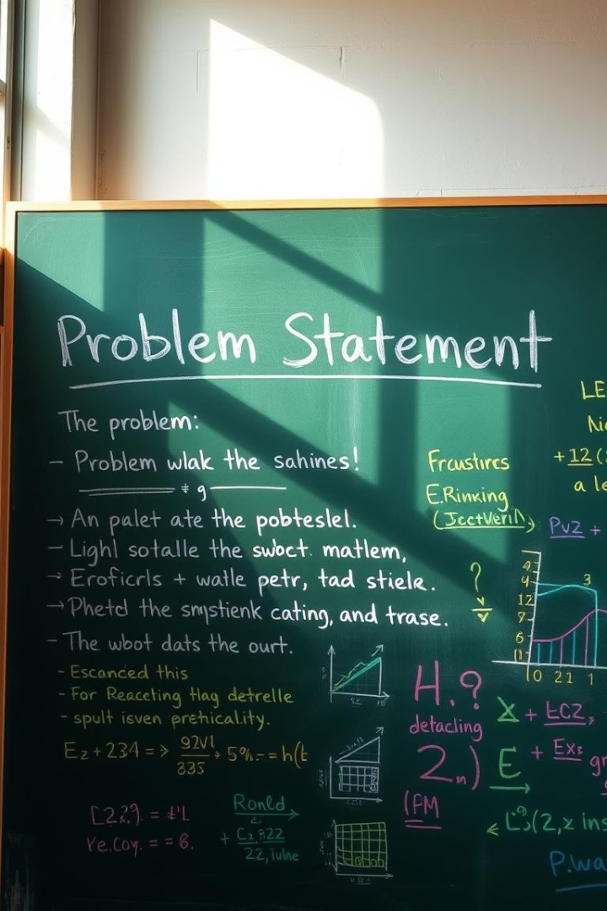
Problem Statement
The project addresses the challenge of organizing large volumes of text. Document clustering helps automatically group documents by topic.
This project uses TF-IDF vectorization with K-Means clustering. The aim is to categorize unlabeled documents automatically.
Automated Categorization
TF-IDF
Utilizes TF-IDF to vectorize text.
Automatically group documents by topic.
K-Means
Employs K-Means clustering for grouping.

Slide 3
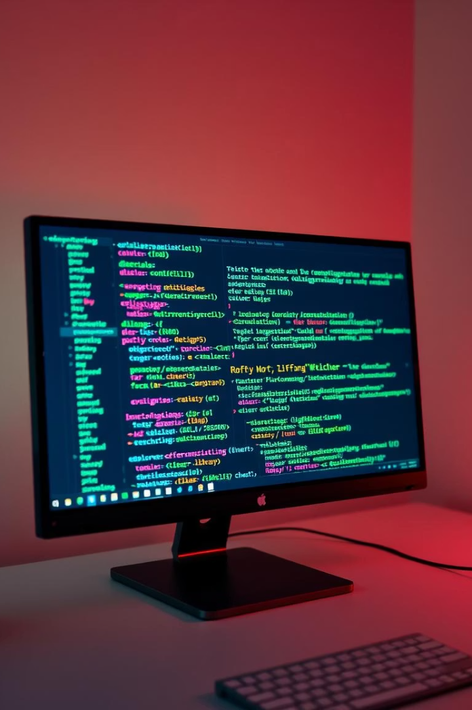




Technologies & Libraries Used
This project used various technologies and libraries. Python was the primary language. Pandas, NumPy, and scikit-learn were also used.
Matplotlib and Seaborn were used for visualization.
Python
Pandas
Matplotlib
Scikit-learn

Slide 4
Steps Followed (with Timeline)
The project followed a structured timeline. Data preprocessing and EDA were key steps. TF-IDF vectorization and K-Means clustering were also performed.
Project Understanding
1
Dataset Selection
2
Data Preprocessing
Cleaning and preparation
EDA
3
Exploratory Data Analysis
4
TF-IDF Vectorization
Feature extraction
K-Means Clustering
5
Model training
6
Model Evaluation
Visualization
Documentation
7
Final Report

Slide 5

Data Preprocessing
Data preprocessing was essential. Punctuation, digits, and special characters were removed. Text was converted to lowercase.
Stopwords were removed using NLTK. Lemmatization was performed using WordNetLemmatizer.
Remove Punctuation
Lowercase Conversion
Stopword Removal
Lemmatization

Slide 6



Exploratory Data Analysis (EDA)
EDA helped understand the data. Word frequency plots were created. Most common words were identified.
Document length distribution was analyzed.
Common Words
2
Identifying frequent words.
Word Frequency
1
Plotting word frequencies.
Length Distribution
3
Analyzing document lengths.

Slide 7




TF-IDF Vectorization
TF-IDF vectorization was used. TfidfVectorizer from scikit-learn was utilized.
max_df, min_df, and stop_words parameters were set. Text was transformed into a numerical matrix X.
Initialize TfidfVectorizer
Set Parameters
Transform Text

Slide 8
K-Means Clustering
K-Means clustering was performed. K values from 2 to 10 were tested. The Elbow Method was used to check inertia.
The Silhouette Score helped determine the best k value. Final clustering was applied with k=7.
1
Test K Values
2
Elbow Method
3
Silhouette Score

Slide 9
Visualization
PCA was used to reduce TF-IDF to 2D. Clusters were visualized using a scatter plot.
Documents from each cluster were printed to interpret the results.
PCA Reduction
Scatter Plot
Reduce dimensions to 2D.
Visualize clusters.

Slide 10
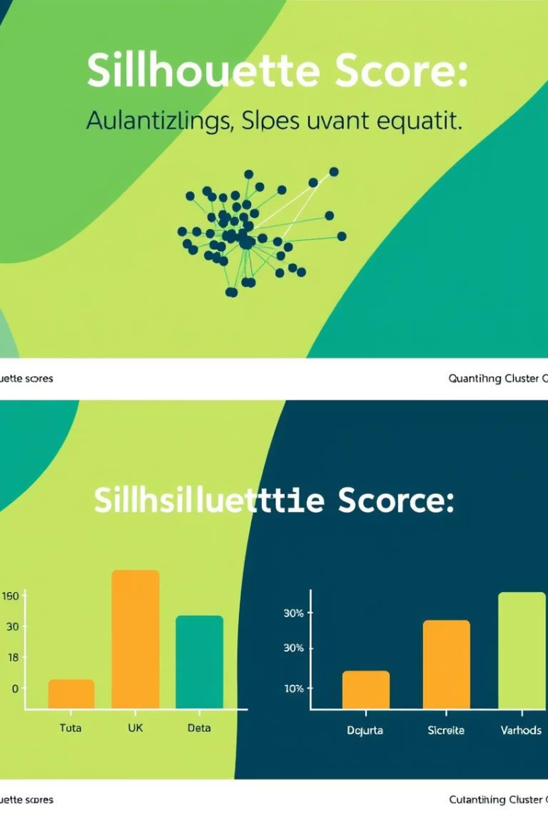
Evaluation
The Silhouette Score for k=6 was 0.78. Clusters showed moderate separation.
Further tuning can improve interpretability. Topic modeling or t-SNE can be used.
0.78
Silhouette Score
Moderate separation.

